Slide 1


Software Project Lab 1
Year 2 Term 1

Slide 2

DUPLICITY CHECKER
By Team BX12

Slide 3
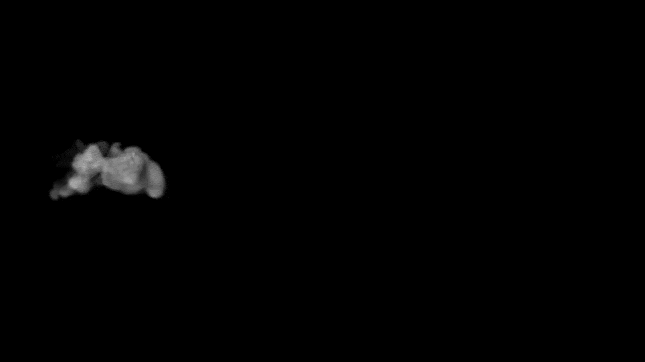
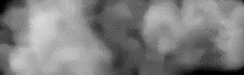
Developed By
WELCOME
Team BX12

Slide 4

Project Mentor
Falguni Roy
Assistant Professor
Institute of Information Technology
Noakhali Science and Technology University
Slide 3

Slide 5
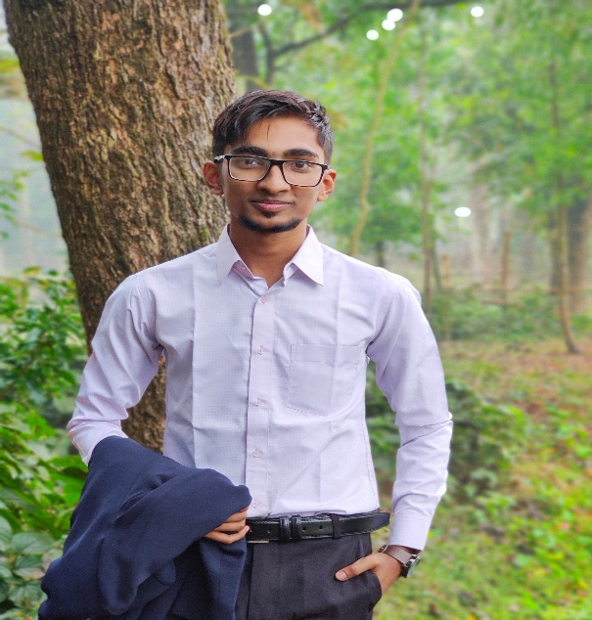

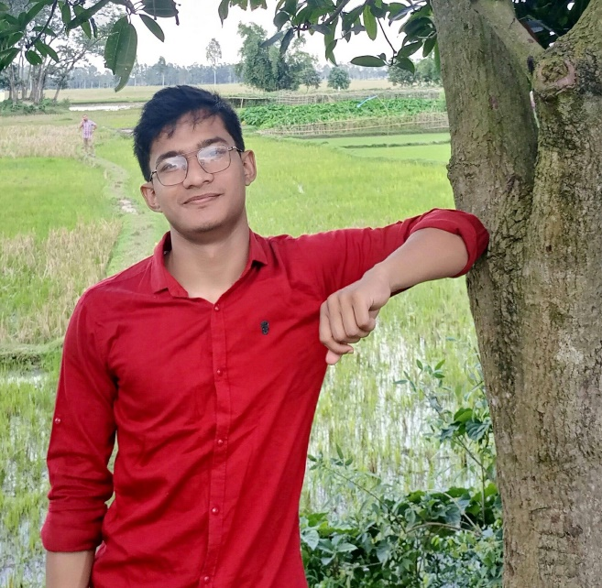
Team Members
01
02
03
Slide 4
Armanur Rashid
Sourav Debnath
Sourav Barman
ASH1925013M
ASH1925022M
ASH1925030M

Slide 6
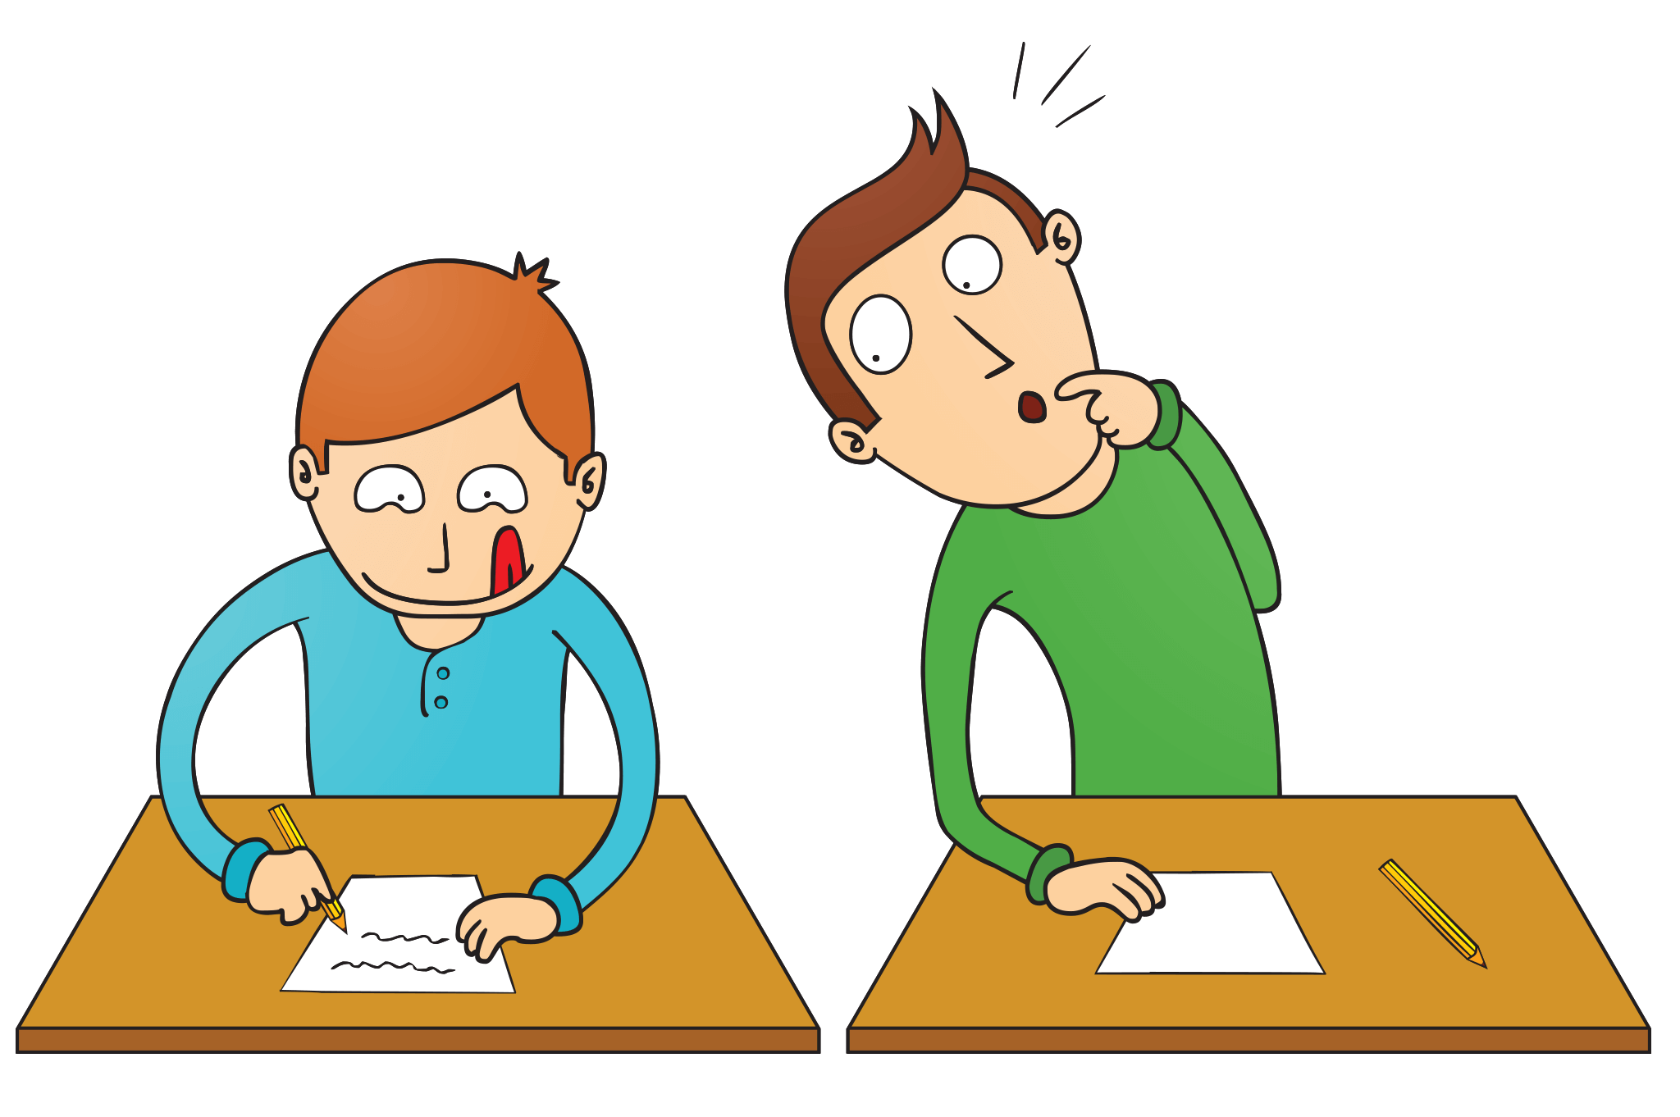
Description
User can compare two or more files.
User can compare files by selecting a folder.
Will show percentage result to user.
Be able to check the Capitalization.
Be able to check the Spell Check.
User can save the file.
Slide 5

Slide 7
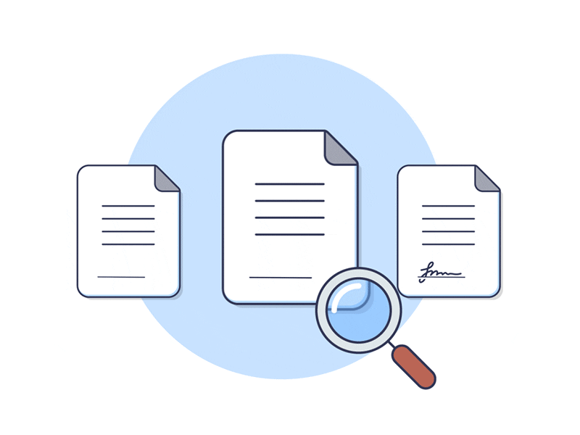

Proposed Requirements
Slide 6
Try to find if there is duplicity between two files
Button sound On/Off

Slide 8


Suggested Requirements
Slide 7
Duplicity Check
Capitalization
Spell Check
Save File
It will check duplicity in all files in a folder
It will check the Capitalization
It will check the spelling of a word
It will save the file

Slide 9


Final Requirements
03
1.1 Random File
1.2 Folder
Spell Check
02
Capitalization
05
04
Save File
Button Sound
Slide 8

Slide 10
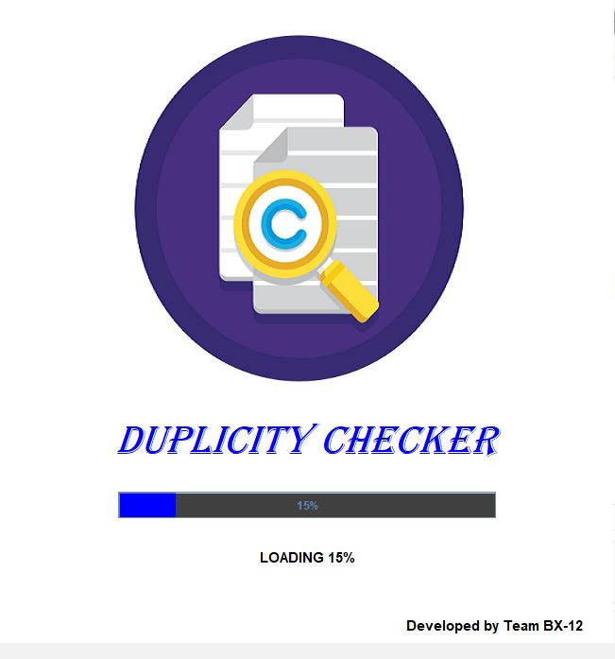
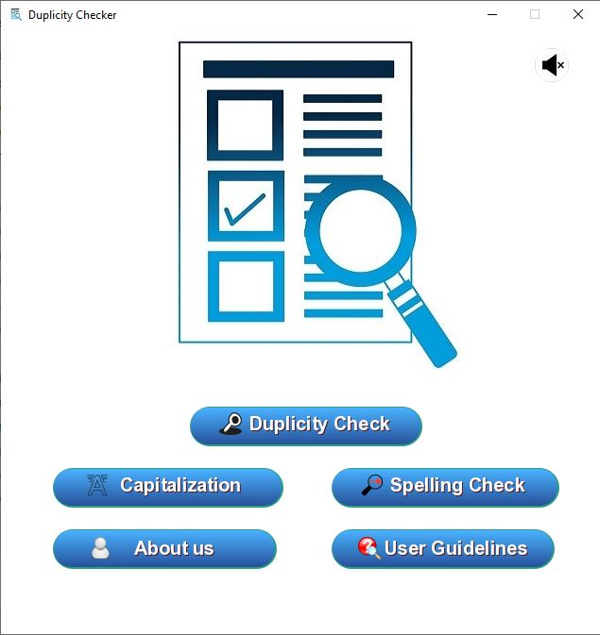
Loading Page Home Page
Slide 9

Slide 11
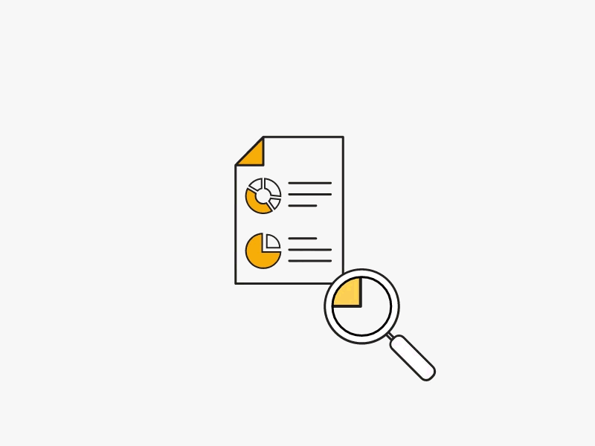
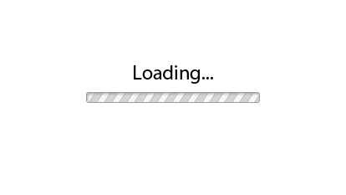

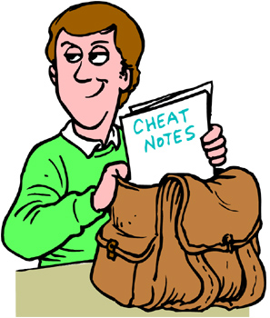
Duplicity Check
Will check duplicity between two or more files.
User can select the desired file by pressing ctrl button.
After clicking the check button, it will show the percentage matching with which file or mark the matched line if matching is done between two files.
The same thing applies with folders.
I am a student.
I am fine.
Matching Line: 1
Percentage: 50%
I am a student.
Slide 10

Slide 12
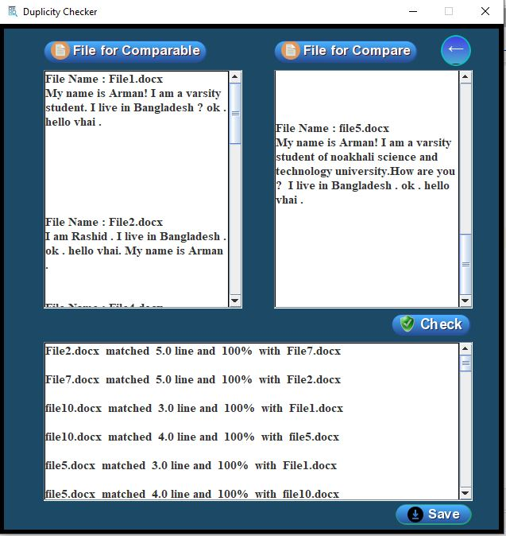
Duplicity Check
Slide 11

Slide 13


Capitalization
After taking a file, it will check if the capitalization in the file is correct.
If capitalization is not correct, it will be fixed after clicking on the check button.
Slide 12
I AM A STUDENT
I am a student

Slide 14
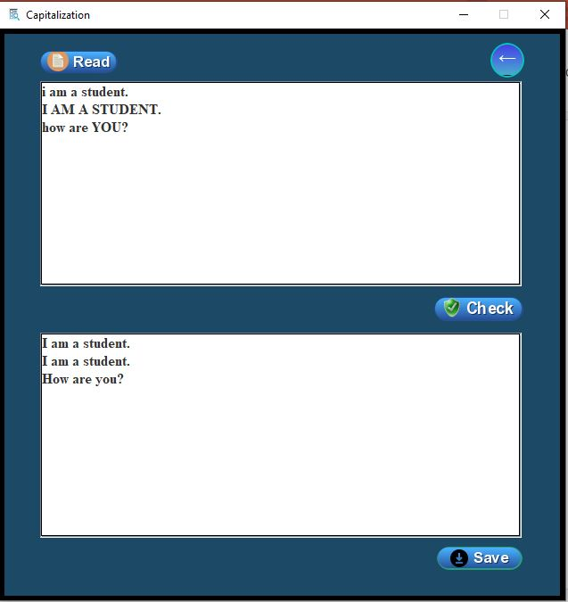
Capitalization
Slide 13

Slide 15
Spell Check
It will search all the wrong words in a file with our stored words to see if there is any wrong word spelling.
If wrong, it will highlight the wrong word.
You can save file after correcting the wrong words.
I am a stdent
I am a stdent
Slide 14

Slide 16
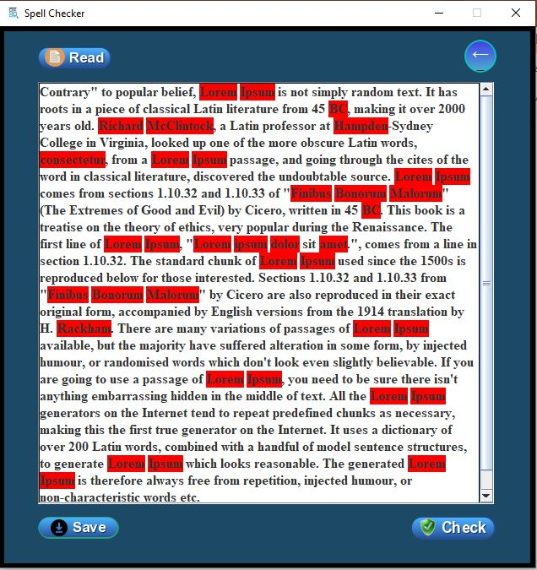
Spell Check
Slide 15

Slide 17





SOLID
Single Responsibility
Liskov’s Substitution
Dependency Inversion
Slide 16
Open Closed Principal
Interface Segregation

Slide 18


Code Refactor
1. Naming Inappropriate
2. Code Duplicity
String xyz, abc;
String file_name, save_file ;
SOLID
Class Inheritance
Slide 17

Slide 19
THANK YOU

